Slide 1
Free Independent Mortgage Advice
That employers and individuals can trust
Benefits of the Service
September 2022

Slide 2
Who are
Charles Cameron & Associates - CC&A?

Slide 3
Company Background
Launched in 2004
Independent, Whole of Market Mortgage & Insurance Advisers
Excellent relationships with all lenders – High Street & Niche
Preferential Rates from many Lenders – unavailable to clients directly
Dedicated broker and full admin support, from team of 100+ Advisers across the UK
£3.2bn mortgage lending in 2021 with over 800 mortgages applications submitted each month
Employees offered Broker Fee Free - £0
Directly authorised by the FCA, for advising on and arranging:
Mortgages –
Residential purchases and Remortgages
Buy to Let purchases and Remortgages as well as
Lifetime Mortgages - Equity Release & RIO's

Slide 4
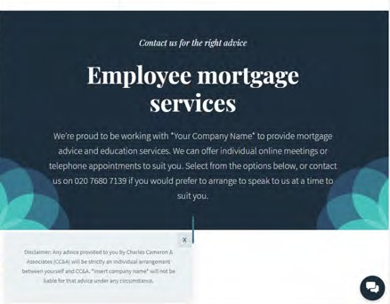
CC&A Services – Mortgage Advice
Virtual 30min meetings with a dedicated Adviser - Pre-Bookable any time and date to suit
8am to 8pm Mon-Fri, Sat 9am to 6pm
Meetings hosted on our own custom built platform – totally secure and requiring no account set up or footprint left
All bookings handled via a dedicated booking site: www.ccameron.co.uk/sample
Notes:
How we are doing it?

Slide 5
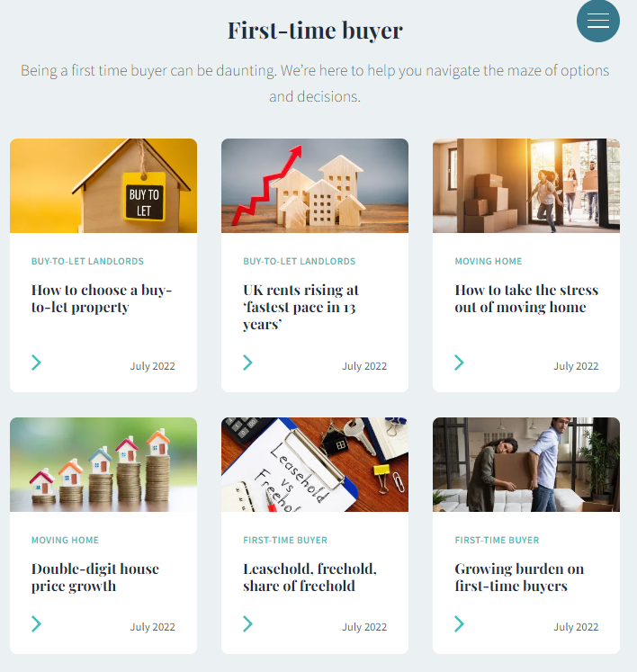
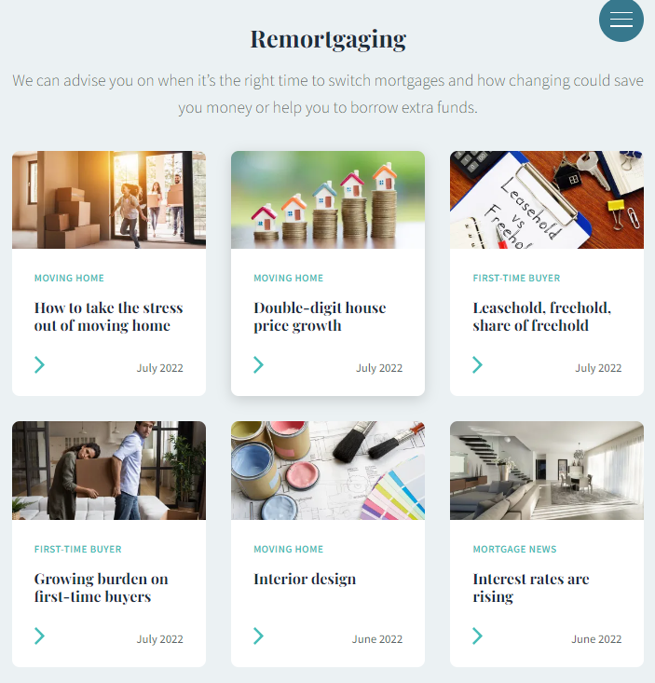
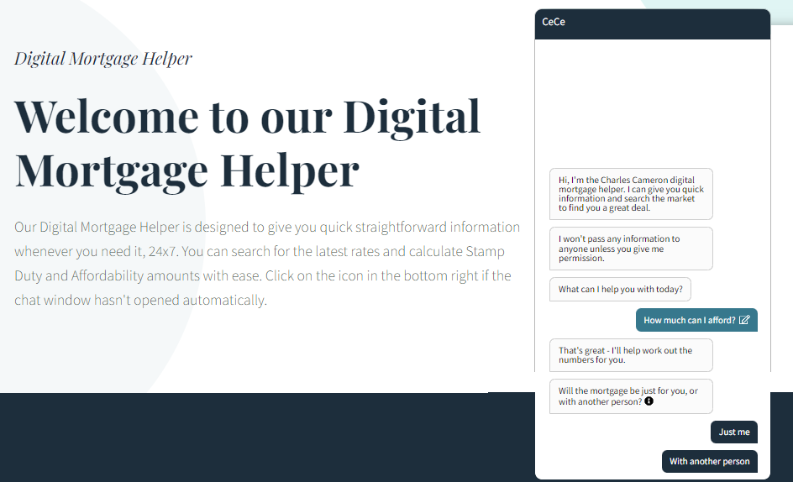
Digital Resources
Educational content is delivered via:
Explainer Videos
Recorded Webinars
Monthly Newsletters & Topical Articles
Blogs & Podcasts
FAQ Series Videos
LinkedIn and Twitter Feed
Check our Knowledge Hub for interesting articles, videos and posts on the Mortgage and Property Market
www.ccameron.co.uk/hub
Use our Digital Mortgage Helper to check real time mortgage rates, calculate monthly repayments, check Stamp Duty costs or download an affordability report
www.ccameron.co.uk/helper

Slide 6
NEW - Mortgage Pledge for Home Owners
Rising Costs
With rising inflation, soaring energy costs, and rising interest rates, all of our corporate clients are actively looking for new ways to save money. That is why we, at Charles Cameron, are doing everything we can to help!
OUR NEW PLEDGE TO YOU
We are now delighted to extend this offer to ALL home owners regardless of who arranged your original mortgage, with our new:
MORTGAGE PLEDGE
For every client that registers for the scheme - we promise to monitor your mortgage and one of our professional, independent advisers will review all of your options, to ensure a new mortgage deal is in place before you ever move on to your lenders Standard Variable Rate of interest.
This could save you £'000's every year. Let us start monitoring your mortgage from today!
Existing Clients
A mortgage is one of the largest debts you are ever likely to have, therefore, if you arranged your mortgage with us, rest assured that we will be monitoring that mortgage and will never let you move on to a higher interest rate than necessary at the end of your tie-in.
www.ccameron.co.uk/mortgagepledge

Slide 7
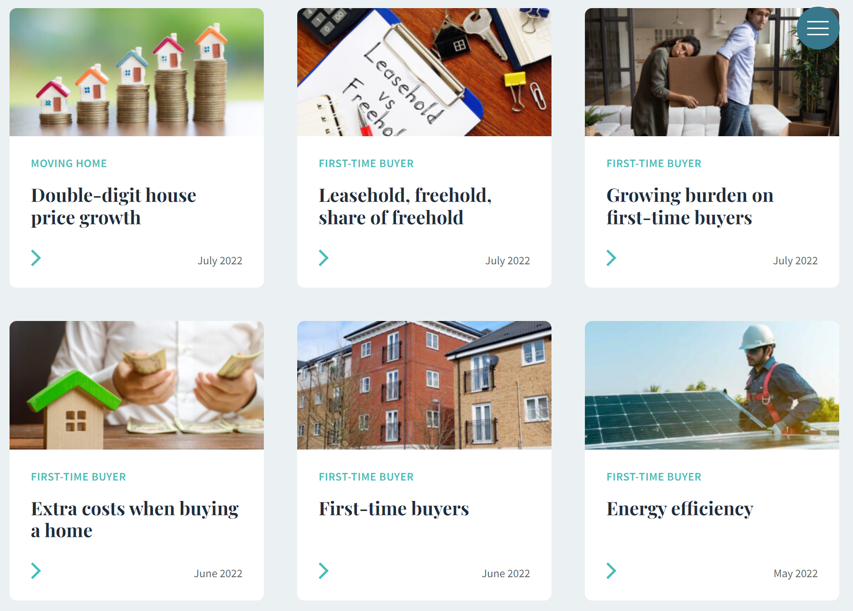
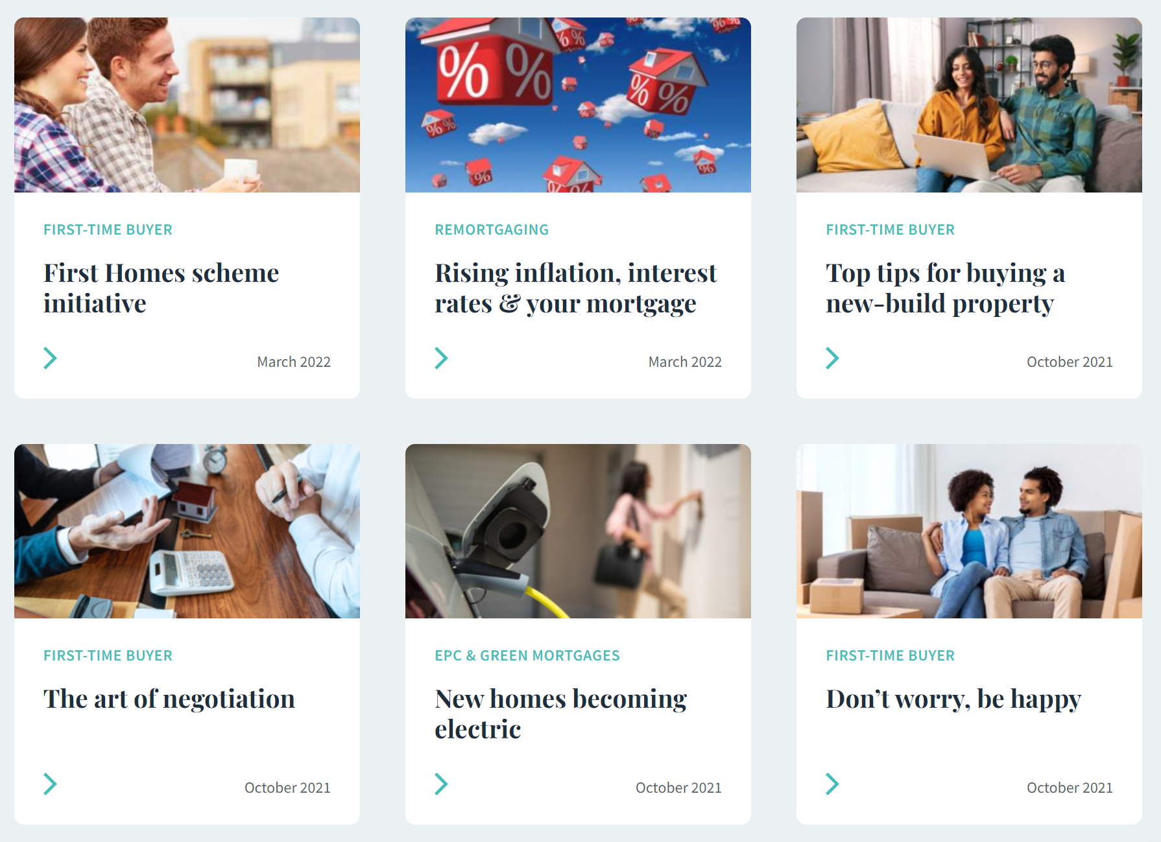
Services for First Time Buyers
Guidance & Coaching
If you are hoping to take your first step on the property ladder, our team of expert advisers are on hand to guide you through the process.
We offer education and advice on:
How to boost your credit rating
How much deposit you will need to save and the impact your level of deposit will have on the amount of products you will qualify for, what repayment costs will be and which lenders will see you the most favourably.
The most appropriate lender and mortgage rate from the whole of the market.
Explain Government initiatives, such as the First Homes, Shared Ownership and Mortgage Guarantee Schemes.
The home purchase process and timeline
All costs and fees associated with buying your first home.
So that you can make stop paying high rental costs and invest in your home instead.

Slide 8
Sustainability Project
We care about the planet and our clients ​
Planting trees for you
We plant one mangrove tree in Madagascar for every mortgage completed and two for every remortgage or client referral!
Our decision came after looking around the world at where the planting would have the most positive impact on their surroundings. Mangroves are important for the climate crisis because estimates suggest that they sequester carbon at a rate of 2–4 x greater than mature tropical forests.
As a result, each mangrove tree removes around 308kg of CO2 from the atmosphere over the course of its life cycle (approximately 25 years).
Mangrove forests also offer numerous other ecosystem services, both short term and long term, such as natural coastal defences from floods and storm surges, increased biodiversity and sediment reduction.

Slide 9
CC&A Partners – Just Move In
Charles Cameron & Associates have partnered with just move in to offer all clients complimentary access to a full home move-in service, managing all of the administration necessary when moving, which usually take hours to sort out yourself.
The cost of this service will be waived as part of a benefit of using Charles Cameron & Associates, saving you £290.
Which services & utilities do Just Move In provide support with?
Council tax notifications
Water and sewerage
Broadband and phone
TV & Media
Removals discounts
Storage
Mobile Phones
Royal mail redirects
TV Licencing

Slide 10
To speak to an adviser for mortgage advice call
020 7953 7040 or email info@ccameron.co.uk
Thank you for listening.
Your home may be repossessed if you do not keep up repayments on your mortgage.
Charles Cameron & Associates Limited is authorised and regulated by the Financial Conduct Authority for advising on and arranging mortgages and insurance broking and debt counselling of consumer credit agreements.
The Financial Conduct Authority does not regulate all Buy To Let mortgages. The Financial Services Register number is 722890.

